Slide 1
DeepState: Symbolic Unit Testing for C and C++
Peter Goodman (Trail of Bits)
Gustavo Grieco (Trail of Bits)
Alex Groce (Northern Arizona University)

Slide 2
Developers don’t use security testing tools
Zero* developers use symbolic executors
Hard to learn and use
Difficult to integrate into a build/test cycle
Confusing and easily crash/run forever/eat up memory
Nearly zero* developers use fuzzers
Requires custom harnesses and build system changes
Security tools are built for bug hunters
“For us, by us”
Work great for auditors, CTF contests, reverse engineers, software testing researchers…
Confusing and alien for software developers
Notes:
Zero is a valid approximation when you take into account paid professional software developers.
Maybe exception for .NET developers since some are built into VS
The number would also be zero for fuzzers if it wasn’t for the efforts of Google/MSFT/Adobe who use fuzzers in their internal dev process have have poured resources into popularizing fuzzers.
LibFuzzer
Security tools we have are great, but they suffer from a “for us, by us” mentality. People who write these tools typically have a “breaking software” versus “building software” mindset.
Even the rest are hard to use. I mean, have you *tried* to use KLEE?

Slide 3
How do developers test code?
Static Analysis
Many tools available, most are commercial
False positives continue to be a vexing problem
57% have never used one (JetBrains Survey)
Unit Tests!
Tooling is free
Test for functionality and security
Nearly everyone is familiar with the concepts
Only 29% do not use unit tests (JetBrains Survey)
Notes:
We want to reach devs who care about testing.
What testing tools do developers actually use?
Of these, static analysis has been around forever. Multiple commercial tools. Most developers don’t use them, with the number one reason being false positives. It doesn’t help that these cost money.
Unit tests are the most common way something is tested.
This is even covered in books and college classes.

Slide 4
Simple Symbolic Testing
What if we made symbolic testing as simple as unit tests?
And fuzzing too!
Fits into existing developer workflow
Integrates with existing code base and build system
Easy to learn and use
Improves software quality
Also tests for correctness, not just security
No false positives!
Extending the parameterized unit testing ideas behind Microsoft’s Pex: open source, many back-ends
Notes:
Developers! (x3) already know how to write unit tests.
What if we made symbolic (and fuzz testing) like unit tests?
They may actually use it.
By changing how testing is done, we can
increase adoption of security testing and
improve software quality
Oh, and without false positives (modulo bugs in testing software, of course)

Slide 5
DeepState: Simple Symbolic Testing
DeepState enables “symbolic unit testing”
Write tests like normal, then say what to fuzz or symbolicate
Instantly get the power of comprehensive symbolic and fuzz testing
Google Test-like API for writing unit tests
Already familiar to software developers
Multiple symbolic execution & fuzzing backends
Open source & freely available
https://github.com/trailofbits/deepstate
Notes:
We thought it was a good idea so we did it.
You just write unit tests like you would for Google Test.
Then you invoke a single command line that can be easily worked into development workflow
You can try it out right now, I recommend you do it. We need users and bug reports.

Slide 6
DeepState Features
Works for both C and C++ programs
Implemented as a single #include and library
Easily switch testing backends
Supports both fuzzers and symbolic executors
Allows for new types of tests
Tests symbolic values and symbolic sequences of functions
Notes:
REAL C++ api. Not “call some C functions” and say it works with C++.
Uses C++ template voodoo in C++ mode (provides symbolic primitives, etc)
We kept the interface simple, because we wanted it to be easy to use.
Write tests once, use multiple backends to test the code
Not only can we select values for a test, but we can also select sequences of functions to test deep program states (get it?)

Slide 7
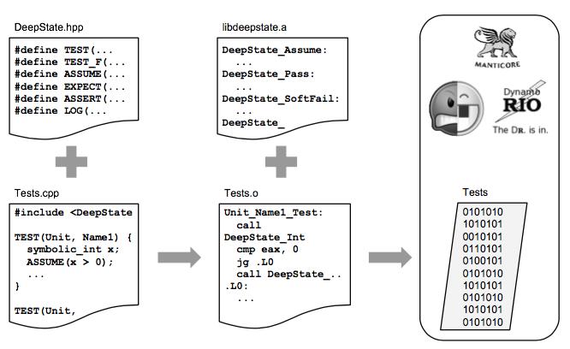
DeepState Architecture
Header
Library
Test cases
Executor
Notes:
Core: Header + Library for C/C++ programs
Test Cases: Developers write this.
Executor: python to wrap calls to angr/manitcore/drfuzz

Slide 8
Using DeepState (writing tests)
bool IsPrime(const unsigned p) {...}
TEST(PrimePolynomial, OnlyGeneratesPrimes) {
symbolic_unsigned x, y, z;
ASSUME_GT(x, 0);
unsigned poly = (x * x) + x + 41;
ASSUME_GT(y, 1); ASSUME_GT(z, 1);
ASSUME_LT(y, poly); ASSUME_LT(z, poly);
ASSERT(poly != y * z)
<< x << "^2 + " << x << " + 41 is not prime";
ASSERT(IsPrime(Pump(poly)))
<< x << "^2 + " << x << " + 41 is not prime"; }
Notes:
This is a real test example
If you are familiar with GTest, you will find this code very intuitive
The DeepState specific tests are in blue, normal GTEST are in red

Slide 9
Using DeepState (writing tests)
Google Test-like macros for tests
TEST, TEST_F
TEST(UnitName, CaseName) creates a new test
TEST_F is like TEST but with a class that performs setup and teardown
ASSERT, CHECK
ASSERT logs and error and stops execution if a condition fails
CHECK is like ASSERT but logs an error and continues execution
Examples:
TEST(PrimePolynomial, OnlyGeneratesPrimes) {...}
ASSERT(poly != y * z);
Notes:
Macros familiar to google test users
The support is not complete, but we hope to increase support as adoption goes up

Slide 10
Using DeepState (symbolic values)
Symbolic Test Features
Symbolic Data Types
symbolic_int, symbolic_unsigned, symbolic_char, ...
DeepState_Int(), DeepState_Char(), … (for C)
Symbolic Range Constraints
ASSUME_* macros
Normal if branches and DeepState_Abandon()
Examples:
symbolic_unsigned x, y, z;
ASSUME_GT(x, 0); ASSUME_GT(y, 1); ASSUME_GT(z, 1);
Notes:
This is the fun stuff!
We have symbolic data types. Just declare a variable as symbolic and it will automatically get symbolized (or fuzzed)
Yes, there is more extensive support than just these
We can use special macros to constrain state search
Or just use normal branches and mark where to abandon

Slide 11
Using DeepState (symbolic values)
Further Limiting Symbolic State
Loops on symbolic bounds lead to state explosion
We can pre-fork symbolic states into a set of concrete states, and execute at native speed
Involves performance/completeness tradeoff
The Pump() function will pre-fork expressions
symbolic_int z; ASSUME_GT(z,0), Pump(z,3); will generate 1, 2, 3
Arbitrary policies are possible
Notes:
Loops on symbolic state happen a lot. This leads to state explosion.
We can optimize and pre-fork via the Pump() function
It will concretize symbolic values and execute at native speed.
Developer controls where to concretize

Slide 12
Using DeepState (symbolic values)
Other Helper Functions
ForAll< types go here >([] ( types go here ))
Verify a property holds for all instances
Malloc(size_t num_bytes): Allocate symbolic memory
SymbolizeData(void *begin, void *end)
Make parts of a buffer symbolic. Useful for testing complex functions that operate on large buffers.
IsSymbolic(T): Determine if a value is symbolic
Minimize(T): Minimum satisfiable value of a symbolic variable
Maximize(T): Maximum satisfiable value of a symbolic variable
Notes:
But wait, there’s more!
DeepState exposes lowe level APIs to allocate symbolic memory and to mark parts of (large) buffers as symbolic.
We can also change test logic depending on the symbolicness of a byte, and query for min/max values.
We also provide handy functions to verify a property holds for all values of a symbol

Slide 13
Using DeepState (symbolic values)
Usage
$ deepstate-angr examples/Primes
INFO deepstate.angr | Running 2 tests across 1 workers
INFO deepstate | Running PrimePolynomial_OnlyGeneratesPrimes ...
INFO deepstate | Passed: PrimePolynomial_OnlyGeneratesPrimes
INFO deepstate | Input: 00 a2 32 89 00 00 00 02 00 00 00 02
...
INFO deepstate | Running PrimePolynomial_OnlyGeneratesPrimes ...
CRITICAL deepstate | Primes.cpp(38): 40^2 + 40 + 41 is not prime
Notes:
This is how you use it. Thats it.
You just run the command and DeepState takes care of everything for you.
Provides values that make output true/false

Slide 14
Using DeepState (API sequencess)
User-Mode Filesystem Example
TEST(TestFs, FilesDirs) {
... initialization ...
for (int n = 0; n < LENGTH; n++) {
OneOf(...
[&r, n, sb, &path] {
MakeNewPath(path);
LOG(INFO) <<
"STEP " << n << ": tfs_rmdir(sb, \"" << path << "\");";
r = tfs_rmdir(sb, path);
LOG(INFO) << "RESULT " << n <<
": tfs_rmdir(sb, \"" << path << "\") = " << r;
},
...
Notes:
DeepState can also be used to test sequences of functions, not just values.
This example tests sequences of operations on a user-mode file system
Will test sequences of LENGTH different ops

Slide 15
Using DeepState (API sequences)
The OneOf operator allows non-deterministic sequences
Flexible on the type of sequence selected
Repeating OneOf("aAbB/."); will generate a string using those characters
Repeating OneOf([]{...code...}, []{...code...}); will generate a sequence of function calls
The backend will determine sequence order, allowing for deep testing of program state :)
Notes:
The OneOf operator is efficiently implemented for both fuzzers and symbex
Allows for testing of function sequences
Can also be used to generate strings from an alphabet

Slide 16
Using DeepState (Logging)
Symbolic Logging
Wouldn’t printf(“%d”, n) print INT_MIN...INT_MAX?
Custom streaming APIs prevent this state explosion
DeepState also re-implements functions like printf
Values concretized after the test ends, so it prints the ranges you expect
Provide LOG(LEVEL) operators for logging operation
Example:
LOG(INFO) << "Setting up!";
Notes:
Symbolic logging is hard. The naive approach fails and would overwhelm the symbolic executor.
We have custom streaming APIs that only print after each test is done
It is not only faster, but also shows the output you’d expect, instead of intermediate garbage
Hook common stream APIs to make this easy to use.

Slide 17
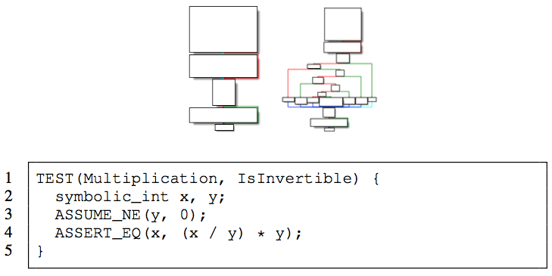
Using Deep State (Fuzzing)
DeepState decomposes integer comparisons
Notes:
The large integer comparison problem is notoriously hard for fuzzers
We decompose large integer comparisons into byte by byte comparisons. Think of it as verifying your password character by character.
Helps coverage-guided fuzzers (e.g. Dr. Fuzz, AFL)
Can implement other simplifications in a similar way

Slide 18
Other Use-Cases
DeepState can test existing code
Testing applications with complex state and setup is very difficult
Modify only relevant code to use symbolic values
Link the DeepState library
Benchmark backends on speed and efficacy
Enough unit tests will provide valuable real-world benchmarking data
Notes:
DeepState can also be used as a bug finding tool
Making the proper values symbolic, rebuild.
Once there is uptake, the deepstate unit tests will provide a set of good bug finding tool benchmark data
Also, this makes it easy to write tests for the underlying analysis tools

Slide 19
Future Work
Short Term:
Gain initial adoption (hey, go try it!)
Implement more backends (like Miasm2, Triton)
Fix bugs & take suggestions on features
Long Term:
DeepState (and similar property testing tools) become a regular part of proper software development
Motivate other testing tools to be more developer friendly

Slide 20
Contact / Questions
Code is available now:
DeepState: https://github.com/trailofbits/deepstate

Slide 21
TestFS
User-mode ext3-like filesystem from U Toronto file system research: J. Sun, D. Fryer, A. Goel, and A. D. Brown, “Using declarative invariants for protecting file-system integrity,” in Proceedings of the 6th Workshop on Programming Languages and Operating Systems. 2011.
Little less than 2KLOC, but complex code

Slide 22
Why file system testing?

Slide 23
File system testing at NASA
Major effort in testing the Mars Science Laboratory flight software at JPL; file system problems nearly caused the failure of the first Mars Rover missions
Our test harnesses were huge, nearly as big as the file system code
Can we reproduce vast human effort to tune the test generation, devise heuristics, using smart fuzzing?

